Slide 1
BIBS
MRM Deep Learning Analysis
최정인

Slide 2
INDEX
01 Data structure
02 Analysis Overview
03 Marker Selection
04 Prediction Method
05 Results

Slide 3
01
Data Structure

Slide 4
MRM DL 분석
01. Data Structure
Peptide | Gene
GDIGETGVPGAEGPR | ADIPOQ
DPTFIPAPIQAK | AGT
QGIQFYTQLK | ALDH6A1
EFGNTLEDK | APOC1
EWFSETFQK | APOC1
VCPFAGILENGAVR | APOH
ILSGDPYCEK | BTD
LSSGLVTAALYGR | BTD
DYFIATCK | C1R
TNFDNDIALVR | C1S
TWYPEVPK | C4BPA
LSLEIEQLELQR | C4BPA
ALLAFQESK | C4BPB
NADYSYSVWK | C5
GGSASTWLTAFALR | C5
TLNICEVGTIR | C6
VLFYVDSEK | C7
EPAVLELEGK | CAP1
VLDVNDNAPK | CDH11
GEWVALNPLR | CFH
TGESVEFVCK | CFH
VFSLQWGEVK | CFI
TLLSNLEEAK | CLU
ASSIIDELFQDR | CLU
Peptide | Gene
GLPGEVLGAQPGPR | COL4A2
CDLISIPK | CORO1C
LSNNALSGLPQGVFGK | CPN2
VSTLPAITLK | CTSD
ELLALIQLER | ECM1
FAVLQENVAWGNGR | FCGBP
LSFQEFLK | FSTL1
ASCLYGQLPK | GSTP1
DGYLFQLLR | HRG
SPAYTLVWTR | HSPG2
LLGIETPLPK | ICAM1
VTLNGVPAQPLGPR | ICAM1
GLIDLTLDK | IFRD1
LIQGAPTIR | IGFBP2
ALAQCAPPPAVCAELVR | IGFBP3
YGQPLPGYTTK | IGFBP3
IQPSGGTNINEALLR | ITIH2
LALDNGGLAR | ITIH4
AGFSWIEVTFK | ITIH4
DSVTGTLPK | KLKB1
Peptide | Gene
IVVVTAGVR | LDHB
GLTSVINQK | LDHB
DLLLPQPDLR | LRG1
VAAGAFQGLR | LRG1
FQASVATPR | MBL2
ALAPEYAK | P4HB
GDSVSDSGSDALR | PDCD4
CDENILWLDYK | PKM2
NIQSLEVIGK | PPBP
ICLDPDAPR | PPBP
NNLELSTPLK | PROS1
DTEVLLVGLEPGTR | PTPRJ
CINQLLCK | SEPP1
GFQQLLQELNQPR | SERPINA5(IPSP)
VAEGTQVLELPFK | SERPINC1
IEDGFSLK | SERPINC1
FLEQECNVLPLK | SFTPB
VTGVVLFR | SOD3
NVLVTLYER | SPARC
GFLLLASLR | THBS1
TIVTTLQDSIR | THBS1
AADDTWEPFASGK | TTR
CMPTFQFFK | TXN
ILLAELEQLK | VIM
68 peptides (54 proteins)
14 proteins of 28 multiple peptides
(2 peptides per each protein)
+ CA19-9
Notes:
현재 가지고 있는 데이터는 stage구분이 없다.
A total of 54 proteins, or 68 peptides, were validated in a large clinical sample [n=1008; 349 normal, 109 pancreatic benign diseases, 149 other cancer (thyroid, breast, and colorectal cancer), and 401 pancreatic cancer] by MRM analysis and ELISA [n=1002; 348 normal, 109 pancreatic benign diseases, 149 other cancer (thyroid, breast, and colorectal cancer), and 396 pancreatic cancer]. The multimarker panel was ultimately constructed by statistical analysis and supporting vector machine (SVM) method.
결국 Elisa data로 진행한듯?

Slide 5
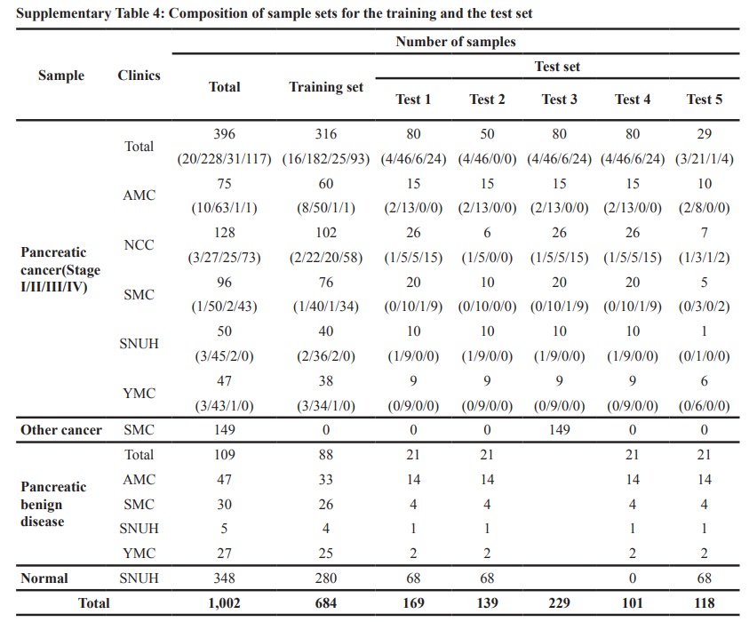
MRM DL 분석
01. Data Structure
Type: PC(Pancreatic Cancer) / OC(Other Cancer) / PB(Pancreatic Benign) / NL(Normal)
현재 데이터는 Pancreatic Cancer의 stage 구분이 없다.
Notes:
현재 가지고 있는 데이터는 stage구분이 없다.
A total of 54 proteins, or 68 peptides, were validated in a large clinical sample [n=1008; 349 normal, 109 pancreatic benign diseases, 149 other cancer (thyroid, breast, and colorectal cancer), and 401 pancreatic cancer] by MRM analysis and ELISA [n=1002; 348 normal, 109 pancreatic benign diseases, 149 other cancer (thyroid, breast, and colorectal cancer), and 396 pancreatic cancer]. The multimarker panel was ultimately constructed by statistical analysis and supporting vector machine (SVM) method.
결국 Elisa data로 진행한듯?

Slide 6
MRM DL 분석
01. Data Structure
Sample | Clinics | Total | Training | Test 1 | Test 2 | Test 3 | Test 4
Pancreatic cancer | Total | 399 | 319 | 80 | 80 | 80 | 25
 | AMC | 75 | 60 | 15 | 15 | 15 | 6
 | NCC | 128 | 102 | 26 | 26 | 26 | 6
 | SMC | 100 | 80 | 20 | 20 | 20 | 5
 | SNUH | 50 | 40 | 10 | 10 | 10 | 3
 | YMC | 46 | 37 | 9 | 9 | 9 | 5
Other cancer | SNUH | 149 | 0 | 0 | 149 | 0 | 0
Pancreatic benign disease | Total | 109 | 88 | 21 |  | 21 | 21
 | AMC | 47 | 38 | 9 |  | 9 | 9
 | SMC | 30 | 24 | 6 |  | 6 | 6
 | SNUH | 5 | 4 | 1 |  | 1 | 1
 | YMC | 27 | 22 | 5 |  | 5 | 5
Normal | SNUH | 349 | 279 | 70 |  | 0 | 70
Total |  | 1006 | 686 | 171 | 229 | 101 | 116
Test1: PDAC vs Control
Test2: PDAC vs Other Cancer
Test3: PDAC vs Pancreatic Benign
Test4: PDAC (low CA19-9) vs Control (Pancreatic Benign + Normal)
Notes:
현재 가지고 있는 데이터는 stage구분이 없다.
A total of 54 proteins, or 68 peptides, were validated in a large clinical sample [n=1008; 349 normal, 109 pancreatic benign diseases, 149 other cancer (thyroid, breast, and colorectal cancer), and 401 pancreatic cancer] by MRM analysis and ELISA [n=1002; 348 normal, 109 pancreatic benign diseases, 149 other cancer (thyroid, breast, and colorectal cancer), and 396 pancreatic cancer]. The multimarker panel was ultimately constructed by statistical analysis and supporting vector machine (SVM) method.
결국 Elisa data로 진행한듯?

Slide 7
02
Analysis Overview

Slide 8
MRM DL 분석
02. Analysis Overview
Test 1
The sensitivity and specificity 의 cutoff value는 training set에서 specificity가 0.9가 되게 하는 값으로 고정 (Oncotarget)
(Oncotarget에선) DeLong’s test로 AUC 계산
본 분석에서는 python에서 Empirical AUC를 구해주는
sklearn package의 method 사용
Test 2
Test 3
Test 4
Notes:
심리학에서 나온 자극-반응의 이론을 토대로,

Slide 9
03
Marker Selection
Using ML feature importance

Slide 10
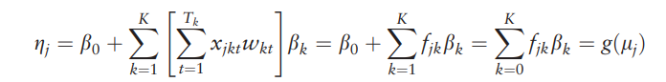
MRM DL 분석
02. Marker Selection Using DNN
Feature Selection Using DNN
Peptide
Protein
Hidden Layer
Group
nn.Linear
+ ReLu
nn.Linear
+ ReLu
Sigmoid
각 Protein의 SHAP value가 클수록 더 중요한 Protein
Notes:
심리학에서 나온 자극-반응의 이론을 토대로,

Slide 11
04
Results compared to Oncotarget

Slide 12
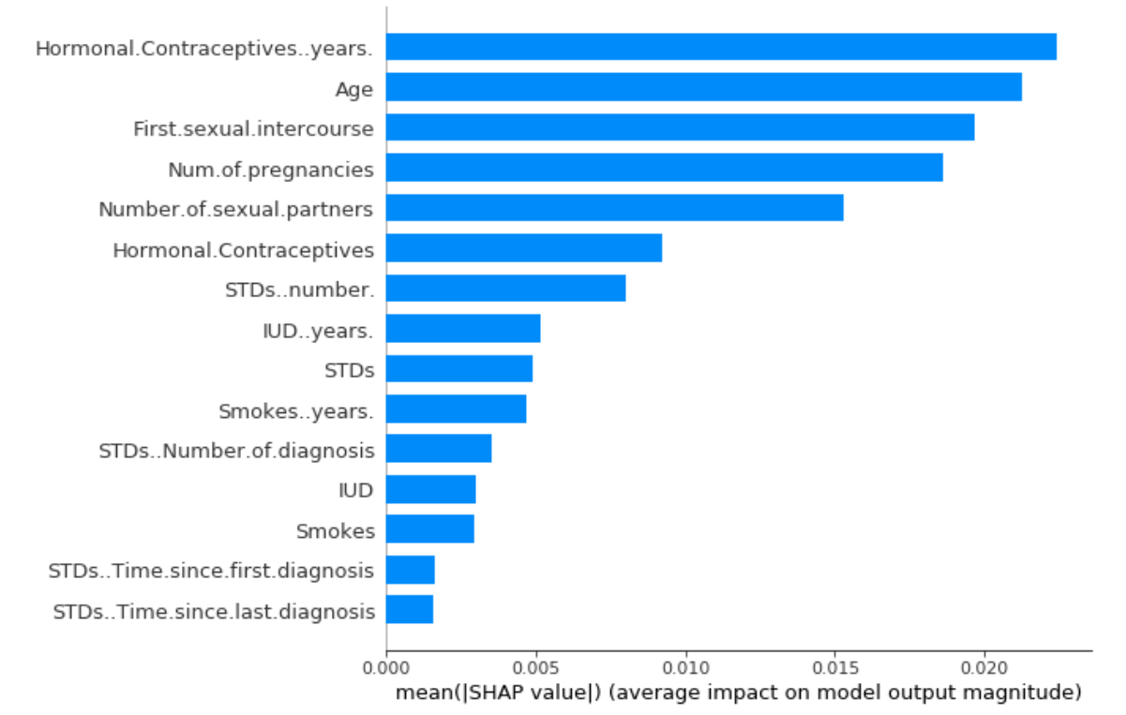
MRM DL 분석
03. Results Compared to Oncotarget
Peptide | Gene
 | CA19-9
AADDTWEPFASGK | TTR
DYFIATCK | C1R
TLLSNLEEAK | CLU
ASSIIDELFQDR | CLU
VLFYVDSEK | C7
DLLLPQPDLR | LRG1
VAAGAFQGLR | LRG1
VFSLQWGEVK | CFI
LSNNALSGLPQGVFGK | CPN2
TWYPEVPK | C4BPA
LSLEIEQLELQR | C4BPA
ALLAFQESK | ITIH2
NADYSYSVWK | C5
GGSASTWLTAFALR | C5
FQASVATPR | MBL2
EFGNTLEDK | APOC1
EWFSETFQK | APOC1
EPAVLELEGK | CAP1
CMPTFQFFK | TXN
Top 15 Gene Selected
& mean(|SHAP value|)
Notes:
심리학에서 나온 자극-반응의 이론을 토대로,

Slide 13
MRM DL 분석
03. Results Compared to Oncotarget
(결과 표)
결과 도출 시,
Cutoff value는 train set의 Specificity가 0.9가 되게 하는 값으로 결정
15C3의 경우의 수 중 train AUC가 큰 순으로 Top 10개의 tripple marker 조합 선정
Test set에 대해선 AUC만 구함
모두 위에서 언급한 peptide – protein - hidden layer 구조의 신경망을 학습시킨 결과
Oncotarget 논문에서 진행한 CA19_9 + LRG1 + TTR, SVM 방법보다 좋은 panel 3개 존재. (AUC 기준)
Notes:
심리학에서 나온 자극-반응의 이론을 토대로,

